Slide 1
The History of Federal Housing
Presents

Slide 2
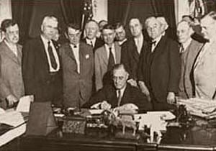
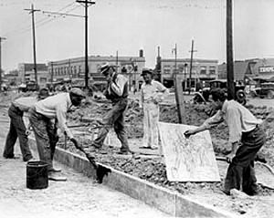
Federally sponsored and subsidized housing evolved due to the growing slums in America and need for employment brought on by the Great Depression. In response to this need President Franklin D. Roosevelt had Congress pass the National Industrial Recovery Act of 1933. This act also created the Federal Emergency Administration of Public Works commonly known as the Public Works Administration (PWA).
The (PWA) was authorized to do the following:
support construction of public buildings and housing
make loans to limited dividend corporations
award contracts to state or local agencies
or build projects on its own

Slide 3
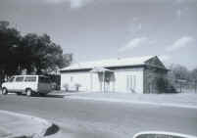
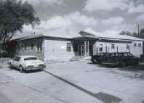
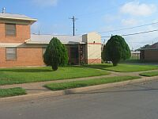
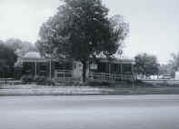
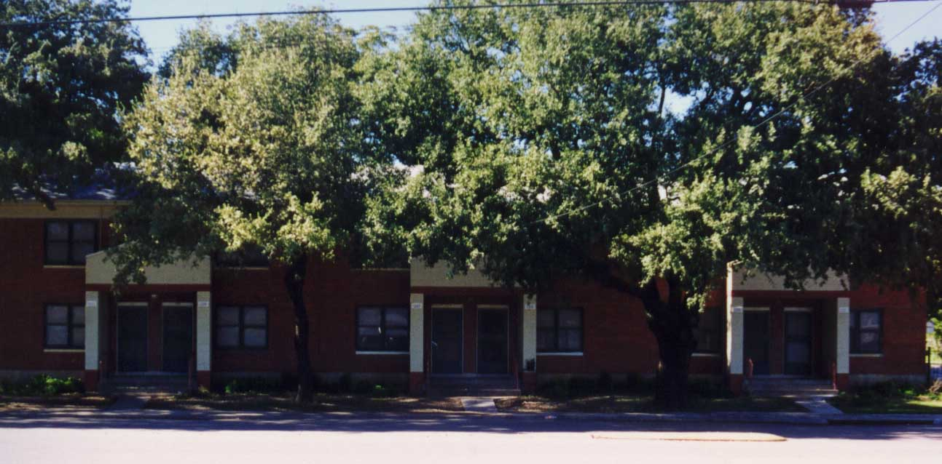
The Year 1933
Between 1933 and 1935 the PWA supported the creation of seven (7) limited-dividend housing projects by providing low interest loans to limited-dividend corporations. However, due to the influence and input of Garden City and European Modernist movements, architects for the PWA projects were encouraged to create innovative designs and plans which produced a high quality project, but also placed rental rates out of the reach of the citizens the program was designed to serve.
Subsequently, the limited-dividend program was suspended and the PWA began direct financing of public housing projects.

Slide 4
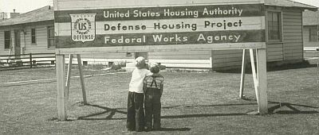
The Year 1937
By the time PWA had completed its responsibilities in 1937; it had accomplished the replacement of the country’s worst urban slums with safe, modern housing and set the stage for the development of a more extensive public housing program throughout the United States.
In 1937 the United States Housing Act of 1937 was a renewal of the federal commitment to provide decent affordable housing for America’s poor and created the federally funded locally-operated public housing programs that operate today.
Under these local programs housing authorities have the authority to initiate, design, build, and operate their housing authorities. The federal government, or at that time the United States Housing Authority (USHA), was to provide program direction, financial support, and technical design assistance.
Under the USHA’s watch more than 370 public housing projects were constructed housing nearly 120,000 families.

Slide 5
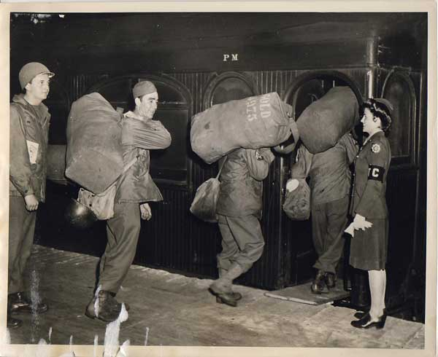
The Years 1940 - 1949
In 1939 the nation’s economy had seemed to rebound from the depths of the depression, and Congress refused to consider a bill to extend the USHA programs beyond the three (3) year term originally mandated. As the Country’s attention turned toward World War II the priority turned from public housing to defense housing.
In 1940 and 1941 all low-rent public housing projects were re-assessed for their ability to contribute to the national defense effort.
All projects constructed in proximity to defense industry centers were converted for exclusive use of war workers and their families. Also all unfinished projects under construction were converted from public housing to defense housing.
By 1942 more than 65, 000 low-rent public housing units had been converted to defense housing. All of those units were absorbed back into the public housing program once they were no longer essential to the war effort.

Slide 6
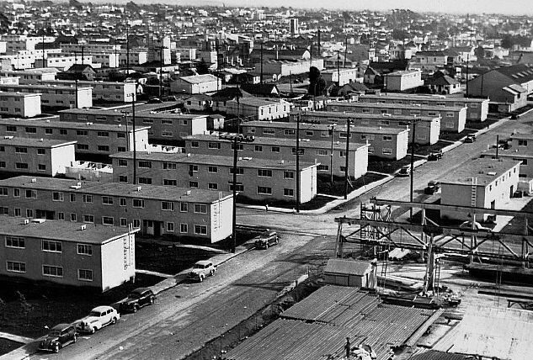
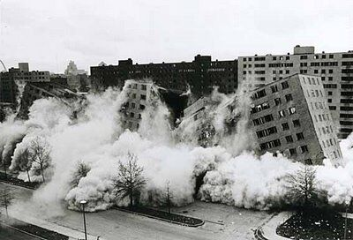
During the period of 1940 to 1944, the federal government built 625,000 housing units under the authority of the Lanham Act. More than 580,000 of these units were of temporary construction and were destroyed after the war.
The Year 1949
The Housing Act of 1949 during President Harry Truman’s administration created three enduring housing initiatives:
made “decent, safe and sanitary” housing a national goal
set off the second wave of public housing construction between 1949 and 1954
began the public-private partnerships that still exist today such as the modernization/rehabilitation
(MOD/REHAB), 202 and Section 8 programs

Slide 7
History of the Housing Authority of the City of Waco & Affiliates
The Waco Housing Authority & Affiliates was established by resolution on February 15, 1938.
The first board of Commissioners were appointed and certified by Mayor C. Gray Cotto.
Those board members were:
Lee Lockwood
W.A. Peters
A.V. Bush
E.A. Flowers
K.H. Aynesworth

Slide 8
Waco Housing Authority & Affiliates Data
Address: P. O. Box 978
Waco, TX 76703-0978
Telephone number (254) 752-0324
Fax number (254) 754-6483
Web Address – www.wacopha.org
Board of Commissioners
Malcolm Duncan Jr.
Shirley Langston
Jon Ramos
Connie Mack
Melli Wickliff

Slide 9
Senior Management Staff
Milet Hopping – President/CEO – Phone 752-0324, ext. 280
Gloria Dancer – Vice President of Housing Operations – Phone 752-0324, ext. 219
Edwina Viera– Vice President of Financial Services – Phone 752-0324, ext. 231
Responsibilities
Annual Budget
Section 8 - $ 14,172,300.00
Central Cost & Low Rent - $ 7,527, 500.00
Non-Profits – $ 2,679,000.00
Mart – $ 309,600.00
Total $ 24,688,400.00
Number of Employees – 74 regular
Number of Public Housing Units (Waco) – 652
Number of Converted PH Units to (RAD) - 250
Number of Public Housing Units (Mart) – 33

Slide 10
Section 8 Allocations
Number of Section 8 Vouchers (Waco) – 2,337
Veterans Administration Supportive Housing (VASH) – 70
Number of Section 8 Vouchers (Hill County) – 204
Number of Section 8 Vouchers (Somervell County) – 17
Total – 2558
Homeownership Program
Number of Section 8 Homeownership Vouchers – 68 (62 Sec. 8, 5 Public Housing & 1 VASH) (VASH uses Sec. 8 for homeownership)
The Family Self Sufficiency (FSS) Program is a voluntary five-year contractual program with goals set by the clients that have to be achieved in order to achieve self-sufficiency from all government subsidized programs.
Number of Family Self-Sufficiency participants – 97
Total FSS graduates – 184

Slide 11
Incomes
There are 2,408 households in Section 8 and 652 households in Public Housing. 96% of these households receive some sort of income. 30% of these households earn an income and 24% receive an income from outside sources (pensions, Social Security/SSI). Below is a breakdown of average incomes earned by residents of public housing developments and Section 8, excluding Social Security, SSI, pensions and welfare assistance.
Estella Maxey $10,888.00
Kate Ross $9,942.00
South Terrace PBV $11,416.00
Section 8 $15,333.91
Non-Profit Units
Raintree Apartments – 156 units
Picadilly Apartments – 6 townhouses
Cimmaron Apartments – 100 units
Hunnington Apartments – 60 units
Misty Square Apartments – 16 units
Total – 338

Slide 12
Collaborations
MHMR - Dean Maberry Center
Homeless Coalition
Housing Coalition
MHMR – Klara’s Center – Early Childhood Initiative
Christian Men’s Job Corp
Restoration Haven
Waco Police Department
Waco Children & Families Counseling Center
Go To College Tour – as a result of these tours, we have 27 youth that have enrolled in a two or four year college and 16 have graduated with a degree
Christian Women’s Job Corps
Waco Educaiton Alliance
VOICE
Acts Church
Lakeshore Baptist Church
Community in Schools
Domestic Violence Response Team

Slide 13
Boards We are Affiliated with
United Way
Housing Coalition
Adopt a School
MCC Adult Education
TSTC Women’s Resource Center
Domestic Violence Response Team
Team Leadership Waco
WacoHousingSearch.org
Caritas
City of Waco Permanent Housing Coalition
Waco Prosper
Permanent Housing Task Force/Homeless Coalition
Fifteen (15) college students from Baylor University, the University of Texas at Arlington & Tarleton University have completed their internships through our Community Services Department

Slide 14
Waco Housing Authority Had an Inventory of 902 Public Housing Units Under the Public Housing Program. In November of 2020 we converted 250 units to RAD at South Terrace Waco, LP
Public Housing Units
10-1 Kate Ross 102 units built in 1941
10-2 Cain Homes 140 units built in 1941 (sold to Baylor University in 1964-65)
10-3 Kate Ross 150 units built in 1953
10-4 Estella Maxey 250 units built in 1959
10-5 Estella Maxey 114 units built in 1965
10-7 Kate Ross 36 units built in 1959
10-8 South Terrace 150 units built in 1968
10-9 South Terrace 100 units built in 1974
The State of Texas has approximately 435 housing authorities in our state.
There are approximately 3500 housing authorities in the United States,
Puerto Rico, and the Virgin Islands.

Slide 15
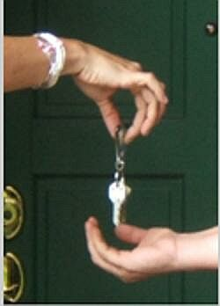
Section 8 Programs
The Waco Housing Authority administers several Section 8 programs. The largest being the McLennan County program. We also have absorbed the Hill County Section 8 program in 2005 and the Somervell County program in 2006. Currently we serve more than 2500 families through these assistance programs with a budget authority in excess of 16 million dollars per year.
We have 70 additional vouchers in partnership with HUD & the VA. The Veteran Assisted Supportive Housing (VASH) Program has assisted 155 Veterans over the last 5 (five) years.

Slide 16
Non-profit Corporation Affordable Housing Affiliates
Rising Images Inc.
The Waco Housing Authority & Affiliates has evolved over the past 20 years to acquired properties that are operated and administered outside of the federal authority.
This helped us to create a self funding resource that has been essential in light of frequent federal budget reductions to our federal housing programs.
These properties are:
Raintree Apartments 156 units acquired in 1994
Cimmaron Apartments 100 units acquired in 1994
Picadilly Apartments 6 townhouses acquired in 1995
Hunnington Apartments 60 units acquired in 1995
Misty Square Apartments 12 units acquired in 2003-04
4 units acquired in 2009
South Terrace, LP (RAD) 250 units under construction as of 2020
Total 588 Units

Slide 17
Dollars Spent in the City of Waco
Site Cost Completion
Raintree
Raintree Bridge Repair $ 14,500.00 11/29/2017
Cimmaron
Roof Replacements $ 48,940.00 11/30/2020
Hunnington
Siding Replacement $ 115,123.02 4/15/2020
All Rising Images Sites
Siding and Roof replacements on 15 various $ 411,832.66 9/27/2018 – 11/14/2019
buildings and painting and repairs of stairs. $ 590,455.66

Slide 18
Dollars Spent in the City of Waco, cont.
Site Cost Completion
Kate Ross/Estella Maxey/South Terrace
Sidewalk Repairs $17,168 8/13/2020
Metal Cabinet Replacement $27,000 6/5/2018
Façade Repairs $76,600 7/30/2018
Fence & Dumpster Pad Repairs $24,399 10/28/2020
Unit Rehab & Fire Damage $197,272.60 1/28/2021
Interior Painting of 50 Units $80,900 8/28/2017
Exterior Lighting Replacement $120,678.81 5/11/2016
Interior Repainting of 314 units $ 494,350 8/31/2017
10 Move in/ Make Ready Units $ 45,650 9/17/2018
Lead Based Paint Testing $ 46,432 9/17/2018
GPNA/EA/ PCA $ 31,920 9/3/2019
Interior Painting of 40 Units $ 64,907 3/11/2020
Add Pea Gravel at Playgrounds $ 4,320.02 6/16/2020
Misc. Roof and Ceiling Repairs $ 9,053.85
$1,223,489.28

Slide 19
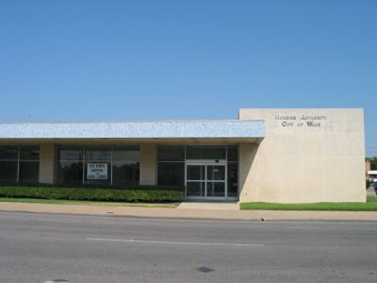
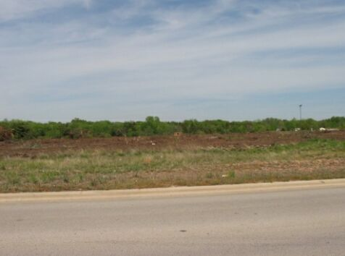
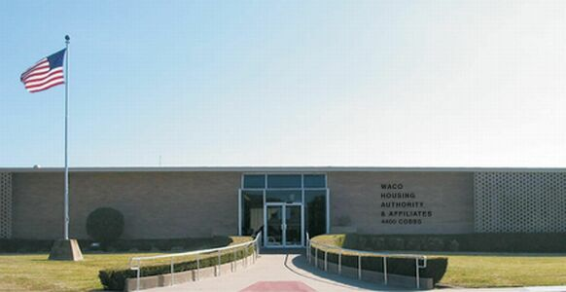
Waco Housing Authority & Affiliates Additional Assets
Waco Housing Authority & Affiliates currently owns:
office building at 1001 Washington Avenue
(currently under lease)
our Central Office located at 4400 Cobbs Drive

Slide 20
Miscellaneous Facts about WHA & Affiliates
The City of Waco has authority to monitor the housing authority’s activities and operation through the appointment of a five-member commissioner’s board. This board is appointed by the Mayor of Waco. The board consists of five members who are appointed to staggered two-year terms. One member of the Board must be a resident. The housing authority staff are not City of Waco employees. Their income and employment is supported through the federal funding of the housing authority.
The housing authority is responsible by federal regulation and guideline to go beyond providing safe, decent housing for our residents. We must also to the best of our ability provide residents with opportunity to move to self sufficiency, and out of the cycle of poverty and assistance dependency. We at WHA & Affiliates make the effort to accomplish that goal through the following programs and agreements:

Slide 21
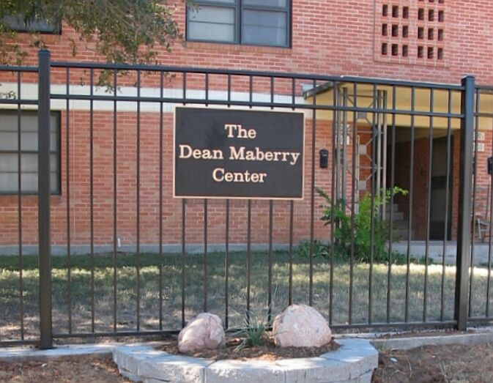
Miscellaneous Facts about WHA & Affiliates
We entered into an agreement with Mental Health & Mental Retardation (MHMR) to provide them 26 units for their clients use. The facility was named the “Dean Maberry Center” in August 2005.
We entered into an agreement with Sanctuary House to renovate and provide three (3) units that are used for WISD homeless families.
The Housing Authority employs a community service staff of seven (7) individuals that accomplish the following:

Slide 22
Miscellaneous Facts about WHA & Affiliates
Assist our senior residents with daily tasks, transportation to doctor’s appointments and grocery needs; they also coordinate exercise classes, learning workshops, and fun excursions.
Assist our youth by following up with WISD counselors on individual students and provide incentives and personal attention to motivate youth to complete school responsibilities. We also have created a college scholarship fund that is awarded to deserving public housing students each year.
Assist our residents by helping them to create their own resident councils that can engage the housing authority in an organized manner on grievances, recommendations, and to have representation in decisions made on ongoing operations.
We have developed computer labs on the property sites for their use in researching job opportunities. We also coordinate workshop opportunities for such things as “How to Conduct Yourself in a Job Interview” or “What to Expect in Homeownership”
Developed a Family Self-sufficiency program
Developed a Homeownership Program
Administer Veterans Administration Supportive Housing (VASH) Programs in the State of Texas

Slide 23
The End
Revision #2 - June 2016

